Slide 1
Geek girls in the Philippines meet drupal
by : GemDev

Slide 2
Who Am i?
Drupal Developer/Client Support @Choc Chip Web Design
Event organizer Philippine Drupal Users Group
Founder of Philippine Geek Girls
Full time mom/wife
Notes:
Beginning course details and/or books/materials needed for a class/project.

Slide 3
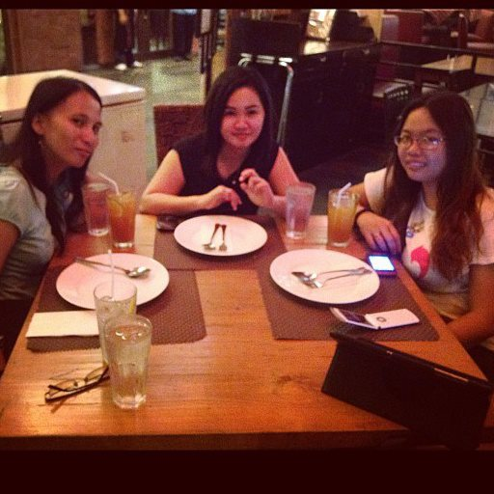
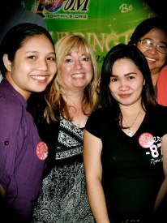
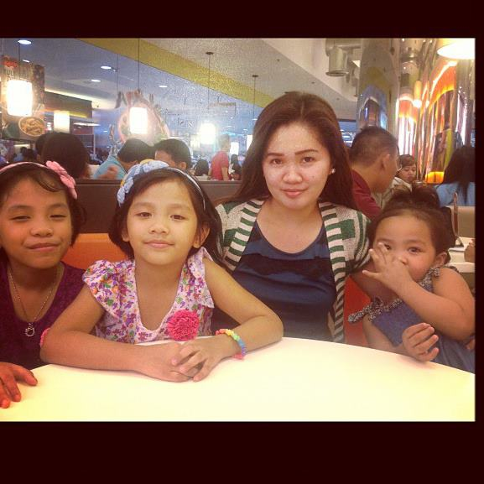
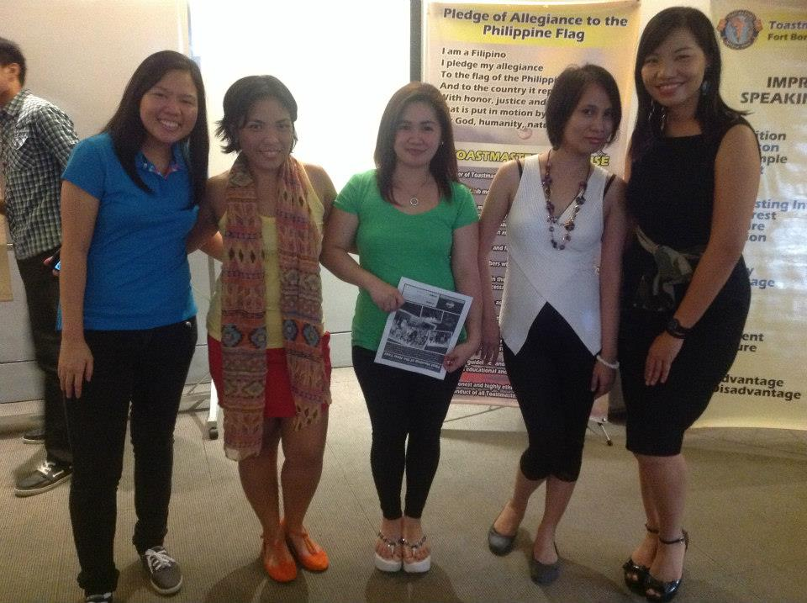
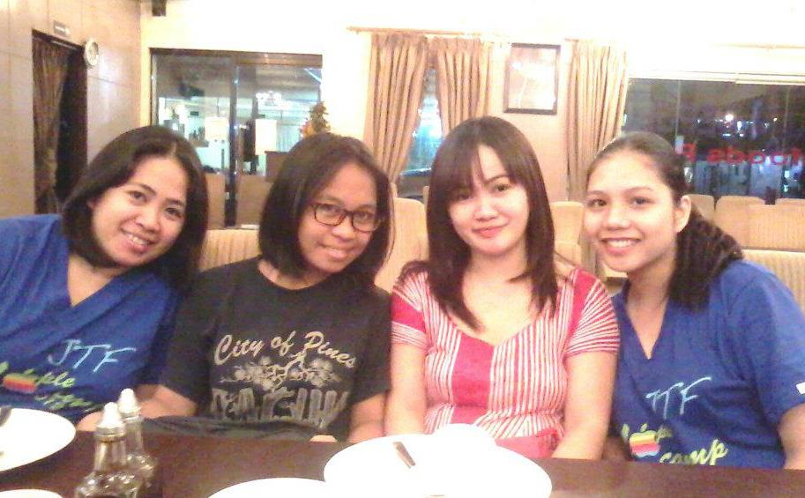
About Me!

Slide 4
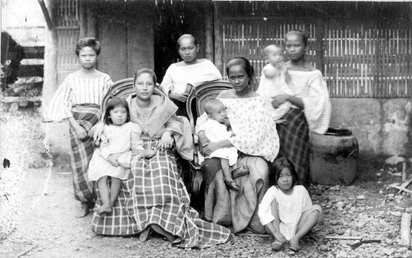
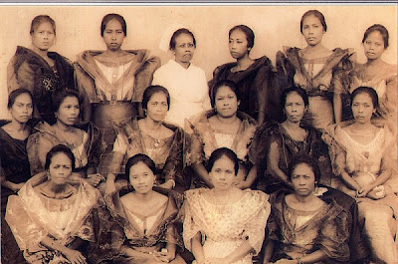
A short overview about women in the Philippines during 1800-1900’s
Notes:
Introductory notes.

Slide 5
Women and their role in the Philippine Society even before 1800-1900
Notes:
Objectives for instruction and expected results and/or skills developed from learning.

Slide 6
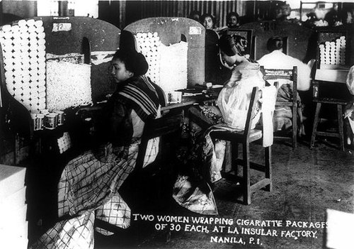
Old Days When women started to be active in the community..19th century

Slide 7
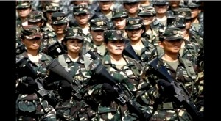
Women of Todays the 20th century Era!

Slide 8
Involvement of women in the community from 1986 to present
Women were given the rights to vote and were able to express their rights of freedom. More companies have hired women and a lot of opportunities were given to women even in the barrio
Started out with barangays, municipalities and cities. Women empowerment became more stronger as times goes by. The involvement in the community was one of the major factor.
Notes:
Relative vocabulary list.

Slide 9
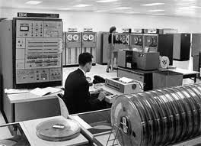
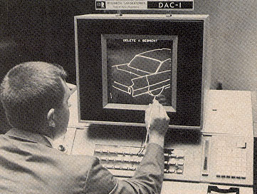
First involvement of women In the IT industry in the Philippines context
After late 60’s where the first computer was introduced by IBM Philippines, followed by Apple up to 70-80-90’s and up to the present time made a major impact on women.
Notes:
A list of procedures and steps, or a lecture slide with media.

Slide 10
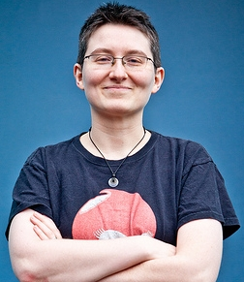
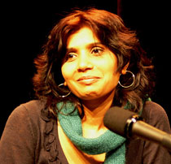
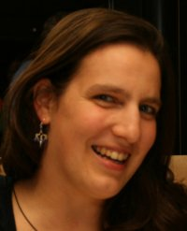
Some of the Most Influential Women on the Web?
Rashmi Sinha-Founder of Slideshare
Angie Byron-Founder of Drupal Chix
Marissa Mayer-Google VP for search products and User experience
Kaliya Hamlin-Evangelist for Open Id community
Notes:
A list of procedures and steps, or a lecture slide with media.

Slide 11
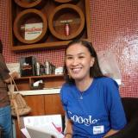
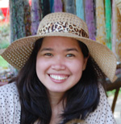
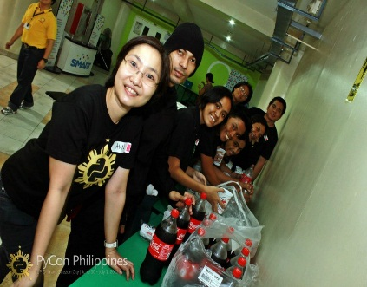
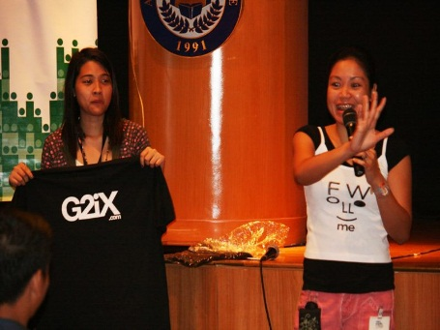
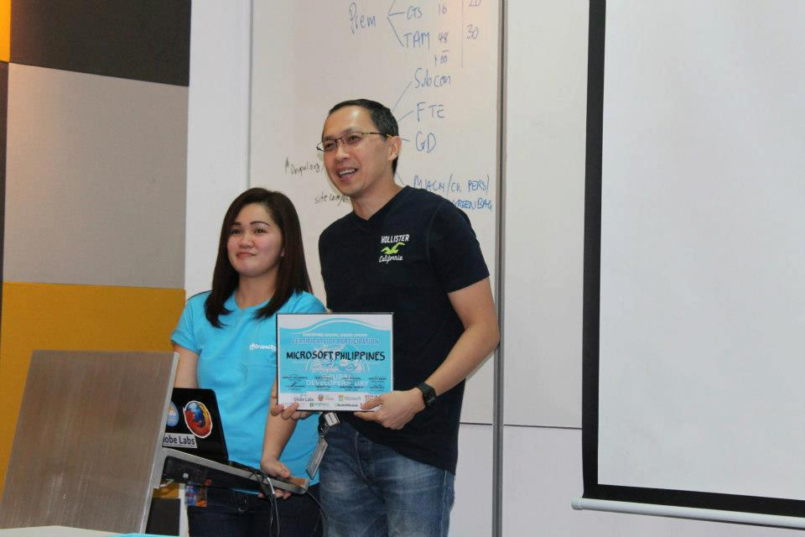
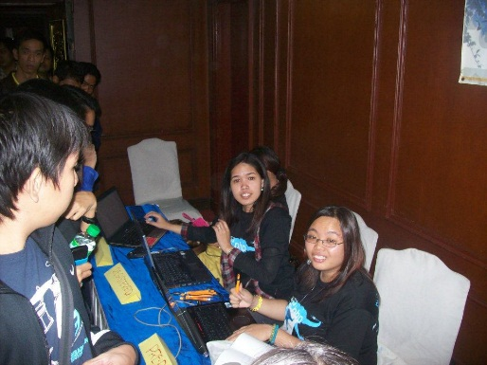
Meet the Female Geek Leaders in the Philippines
Aileen Apollo-Google
Ann tan Pohlman-Python Users group
Gem Devanadera-Philippine Drupal Users Group
Cherrie Ann Domingo-PHP users group
Florida Ortiz-Developers Connect
Notes:
A list of procedures and steps, or a lecture slide with media.

Slide 12
How then the Geek females in the Philippines get to know Drupal?
Python, Php, Ruby on rails, Drupal, Joomla- Despite of the differences with the programming language that we use , as a community we help each other by supporting one another in different aspects, through meet ups, events, gathering and social meetings, or parties, we learned that it is better to collaborate than compete with each other.
Notes:
Conclusion to course, lecture, et al.

Slide 13
In what ways we do help each other?
By promoting one another. How?
Through social medias announcement ,promotions and advertisement using (twitter,fb,google plus)
By supporting one another. How?
Through sending out some sponsorships from our own community, providing speakers to one another , blogging every events we have with them .
By collaborating to ane another. How?
through meet ups, social gatherings, events.
Notes:
An opportunity for questions and discussions.

Slide 14
Philippine Drupal Users Group since
Started from the year 2009 up to 2013
PHDUG was known for becoming one of those non-profit org in terms of advocating individuals in different universities in the Philippines.
For the awareness of using open source software as a platform to all individuals:
To inspire people and promote team works through continues planning and organizing of events and to be active in participating in the community .
Notes:
An opportunity for questions and discussions.

Slide 15
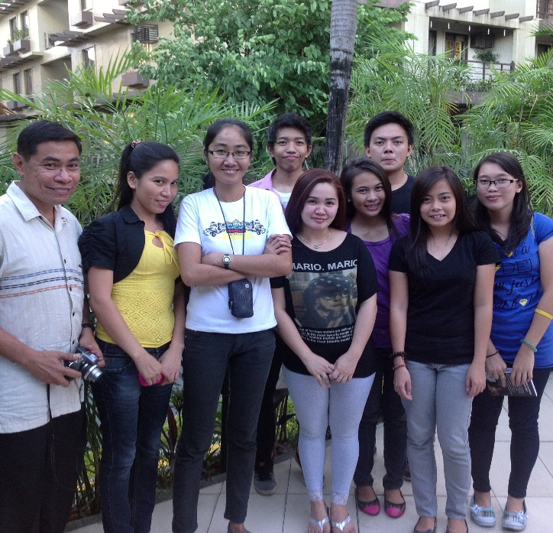
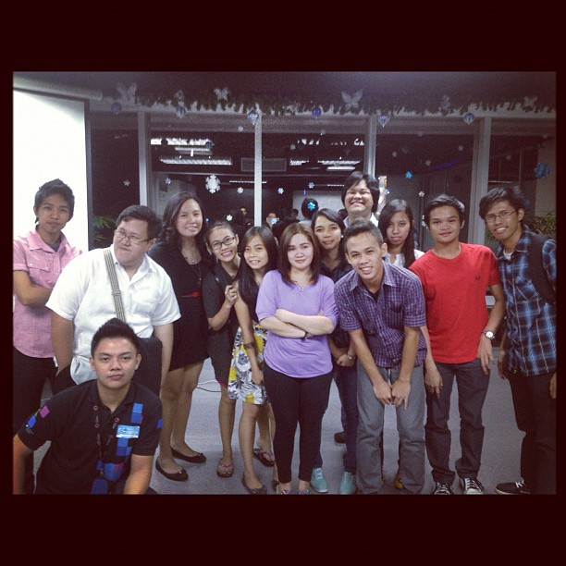
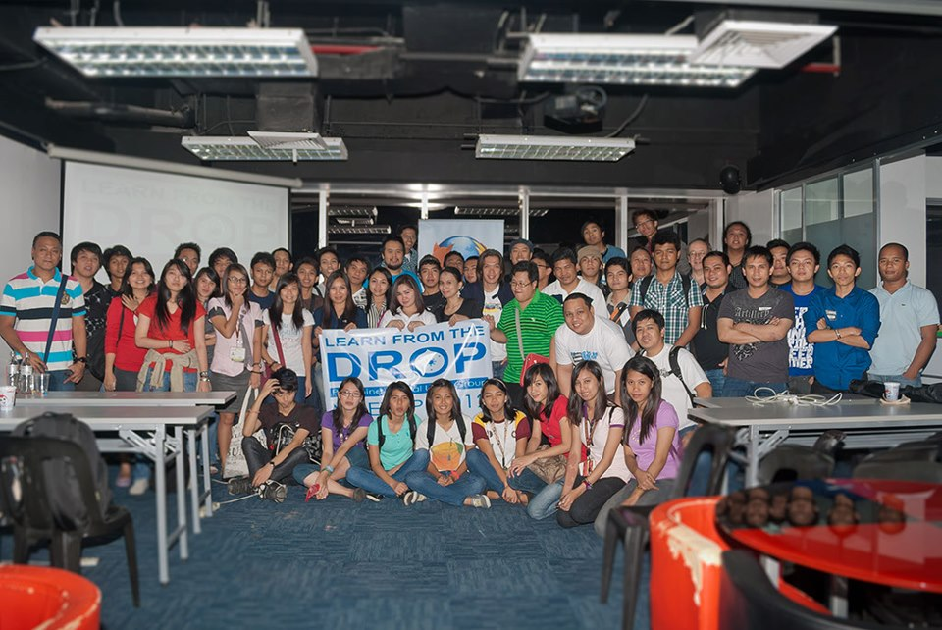
Geek Female Roles in the PHDUG community?
Notes:
An opportunity for questions and discussions.

Slide 16
Their vital role in PHDUG
Female Geeks help out with the organizing of the event. And helps Blogging of the events.
Markets and advertise our groups to different organization and school events.
Network connections.
Some geek girls are also mothers that is why they understand deeply the emotion between individuals specifically to young volunteers
They help in financial management for the group in terms of budgeting
Notes:
An opportunity for questions and discussions.

Slide 17
Common Problems being encountered By geek girls leaders in the Philippines
Notes:
An opportunity for questions and discussions.

Slide 18
What is the best way to do to overcome this?
The 4 ways of Openness:
Open Communications for everyone.

Slide 19
Open for Corrections!

Slide 20
Open for a Change!

Slide 21
Open for New ideas!

Slide 22
This is how I manage to survive the Group after 2012!
Notes:
An opportunity for questions and discussions.

Slide 23
Things that I learned and achieve after giving my best for the community of PHDUG!
Notes:
An opportunity for questions and discussions.

Slide 24
After all it is all About women’s world!
Notes:
An opportunity for questions and discussions.

Slide 25
How do you define Geek Ladies?
Notes:
An opportunity for questions and discussions.

Slide 26
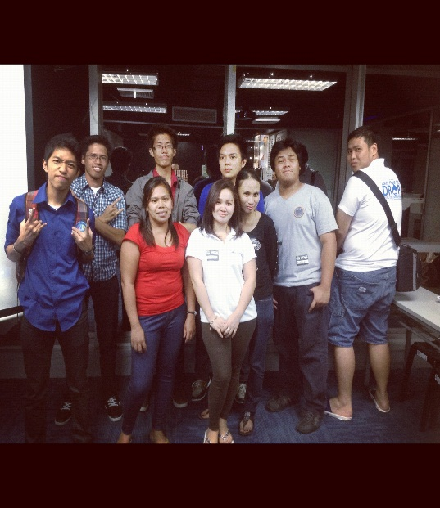
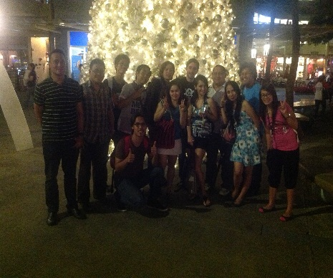
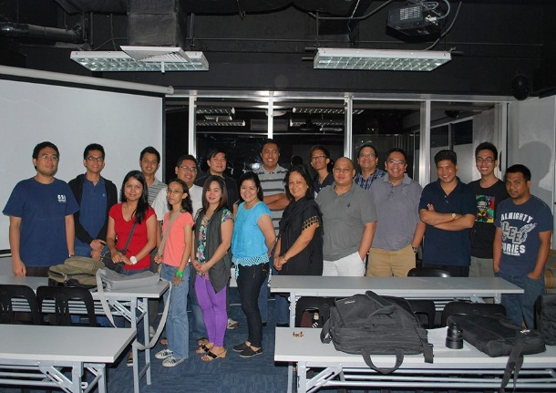
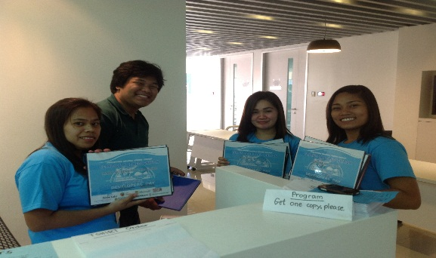
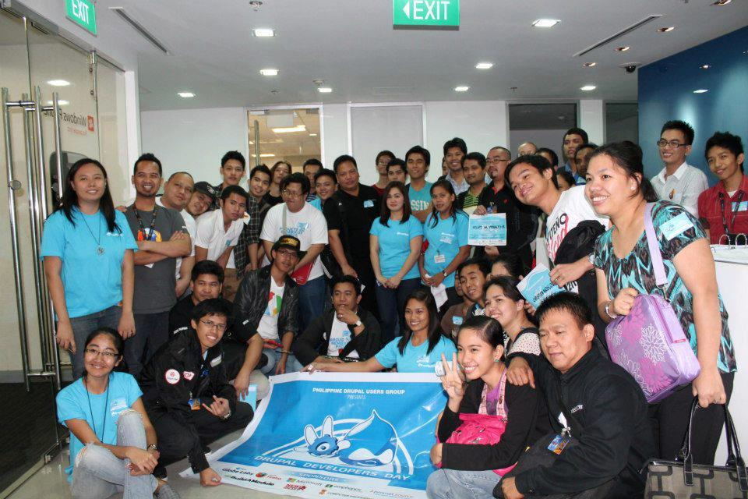
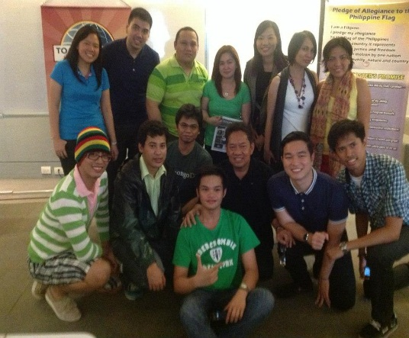
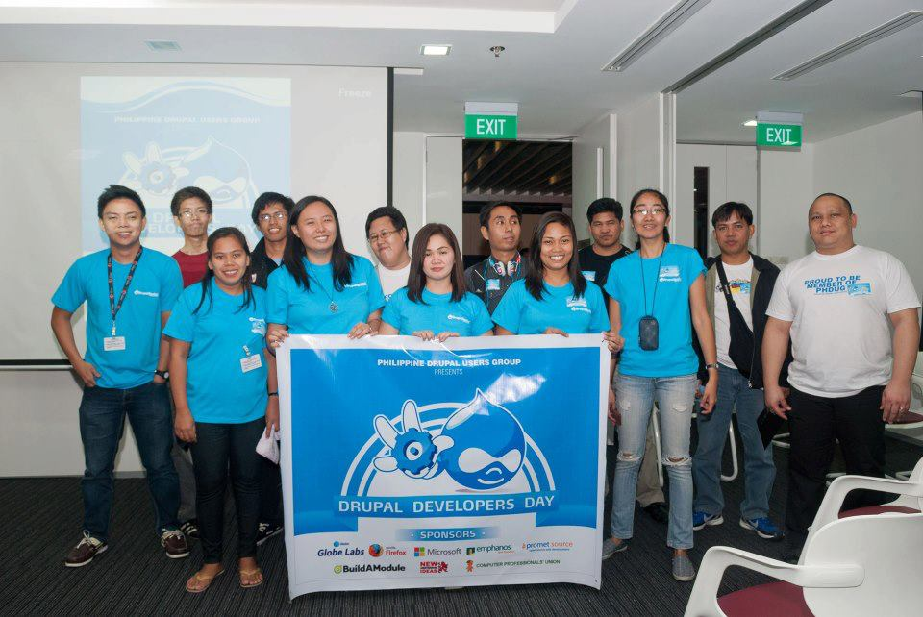
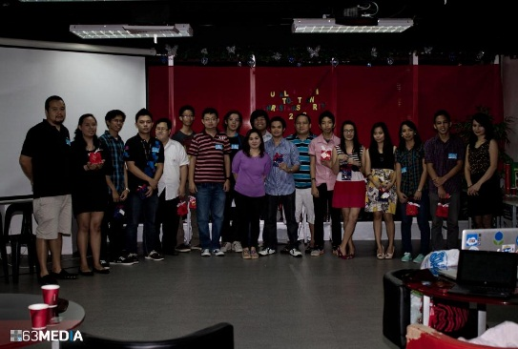
Our PHDUG ‘Drupal ‘events in Manila !

Slide 27
Know more about Us!

Slide 28
To know more about me and PHDUG (please feel free to check out website)
-www.drupalcampmanila.com
Like us on Facebook - Philippine Drupal users group
- Like us on google+-Philippine Drupal users group
Email : gemdevanadera@drupalph.org
Company email: gemma@chocchip.com.au
Telephone : +632 -8042911
Mobile: +632-9154056431
Philippine Drupal Users Group has an upcoming event on Feb. 16, 2013 and we would like to invite anyone who are planning to go to Philippines by this month to come and check on our manila events.
Thank You! Mabuhay to DrupalCon Sydney 2013! More powers to all sponsors of this event , thanks to Linux Australia for the scholarship and to Drupal Association group and to all Organizers of this wonderful event .
Notes:
An opportunity for questions and discussions.

Slide 29
For references of pictures and images are excerpted from this link:
http://www.google.com.ph/imgres?um=1&hl=en&sa=N&tbo=d&biw=1366&bih=664&tbm=isch&tbnid=UW2naO8OkC2IJM:&imgrefurl=http://www.getbracknell.co.uk/news/s/2066360_funding_crunch_axes_mental_health_charity&docid=2warzO6-DnuRDM&imgurl=http://m.gmgrd.co.uk/sbres/452.%2524plit/C_67_article_2066360_body_articleblock_0_bodyimage.jpg%253F24%25252F02%25252F2010%25252008%25253A48%25253A24%25253A612&w=298&h=298&ei=WxL2UKXhOKSeiAe66YCYAw&zoom=1&iact=hc&vpx=379&vpy=91&dur=23&hovh=225&hovw=225&tx=121&ty=120&sig=110067581504820595908&page=3&tbnh=143&tbnw=140&start=54&ndsp=27&ved=1t:429,r:56,s:0,i:253- lack of funding
lack of support- http://www.flickr.com/photos/assbach/220318384/
misunderstanding- http://www.google.com.ph/imgres?um=1&hl=en&tbo=d&biw=1366&bih=664&tbm=isch&tbnid=D3CjJITC0Xz46M:&imgrefurl=http://www.amaljyothibeats.com/a-slight-misunderstanding-behind-the-screen/&docid=Gf9sfAQz4oqSOM&imgurl=http://www.amaljyothibeats.com/wp-content/uploads/2011/01/istockphoto_10346133-3d-character-and-misunderstanding-they-have-conflict.jpg&w=380&h=380&ei=jxX2ULj4HIyiiAfKu4HIBw&zoom=1&iact=hc&vpx=1018&vpy=307&dur=1935&hovh=225&hovw=225&tx=153&ty=148&sig=110067581504820595908&page=2&tbnh=145&tbnw=154&start=23&ndsp=31&ved=1t:429,r:29,s:0,i:234
Bossy women- http://www.sodahead.com/living/men-are-feisty-and-bossy-women-admirable/question-3208663/?link=ibaf&q=&imgurl=http://3.bp.blogspot.com/-6MH4NLaiz50/Tygs7yrPoZI/AAAAAAAAKGg/ZBz5EnWRzqk/s1600/bossy-woman.jpg
Lack of passiom- http://www.google.com.ph/imgres?um=1&hl=en&tbo=d&biw=1366&bih=664&tbm=isch&tbnid=O6Z2-xIyLi5wQM:&imgrefurl=http://notecardpoetry.wordpress.com/2012/04/04/lack-of-passion-is-a-lack-of-life/&docid=8TXvYW89N-VHjM&imgurl=http://notecardpoetry.files.wordpress.com/2012/04/img_0068.jpg&w=2984&h=1760&ei=4Bn2UPSFIIyTiQf-vYGgDg&zoom=1&iact=hc&vpx=787&vpy=134&dur=33&hovh=172&hovw=292&tx=81&ty=120&sig=110067581504820595908&page=1&tbnh=131&tbnw=236&start=0&ndsp=28&ved=1t:429,r:4,s:0,i:88
None techie- http://www.google.com.ph/imgres?um=1&hl=en&sa=X&tbo=d&biw=1366&bih=664&tbm=isch&tbnid=xsVPJuzflAPwPM:&imgrefurl=http://www.bablotech.com/2009/01/06/12-reasons-why-windows-is-better-than-linux-for-non-techies/&docid=bWzzk3W4uIJSxM&imgurl=http://www.bablotech.com/wp-content/uploads/2009/01/windows-vs-linux.jpg&w=490&h=302&ei=Yhr2UJ3oA-iZiAeI4IGIBg&zoom=1&iact=hc&vpx=234&vpy=137&dur=5282&hovh=176&hovw=286&tx=106&ty=92&sig=110067581504820595908&page=1&tbnh=141&tbnw=229&start=0&ndsp=30&ved=1t:429,r:1,s:0,i:79

Slide 30
References for images:
http://www.google.com.ph/imgres?um=1&hl=en&tbo=d&biw=1366&bih=664&tbm=isch&tbnid=xBkhP0qmK82FTM:&imgrefurl=http://educationsc.com/open-communication.php&docid=aO_9vRhL0IVcnM&imgurl=http://educationsc.com/images/open-communication.jpg&w=425&h=282&ei=7Bv2UJDYAe-fiAeIuYG4Bg&zoom=1&iact=hc&vpx=607&vpy=130&dur=1399&hovh=183&hovw=276&tx=123&ty=87&sig=110067581504820595908&page=1&tbnh=135&tbnw=170&start=0&ndsp=26&ved=1t:429,r:4,s:0,i:88
Open for corrections or criticism- http://www.google.com.ph/imgres?um=1&hl=en&tbo=d&biw=1366&bih=664&tbm=isch&tbnid=FshLUXZ-AQor7M:&imgrefurl=http://motivationcube.wordpress.com/2012/10/10/have-you-opened-yourself-to-crticism-if-not-then-do-it-today/&docid=mrJjrbItEjNYAM&imgurl=http://motivationcube.files.wordpress.com/2012/10/open-to-criticism-e1349835104453.jpg%253Fw%253D593%2526h%253D260%2526crop%253D1&w=593&h=260&ei=vxz2UIugO8auiQesg4D4AQ&zoom=1&iact=hc&vpx=825&vpy=145&dur=2371&hovh=148&hovw=339&tx=231&ty=72&sig=110067581504820595908&page=1&tbnh=113&tbnw=258&start=0&ndsp=25&ved=1t:429,r:4,s:0,i:88
Open for a change- http://www.google.com.ph/imgres?um=1&hl=en&tbo=d&biw=1366&bih=664&tbm=isch&tbnid=o5b7Td3SXrTavM:&imgrefurl=http://hcoey.tripod.com/id96.html&docid=TEw0peUcDiqS3M&imgurl=http://hcoey.tripod.com/sitebuildercontent/sitebuilderpictures/.pond/open4changelogo.jpg.w300h333.jpg&w=300&h=333&ei=UR32UJvtOq-TiQfKzIH4Dg&zoom=1&iact=hc&vpx=1044&vpy=111&dur=1567&hovh=237&hovw=213&tx=135&ty=100&sig=110067581504820595908&page=1&tbnh=151&tbnw=136&start=0&ndsp=28&ved=1t:429,r:5,s:0,i:91
Open for new ideas- http://www.google.com.ph/imgres?um=1&hl=en&tbo=d&biw=1366&bih=664&tbm=isch&tbnid=gI77qrH1AarKeM:&imgrefurl=http://mysterious-kaddu.blogspot.com/2010/09/live-life-be-open-to-new-ideas.html&docid=KBL6bp3FTQADuM&imgurl=http://4.bp.blogspot.com/_ZwgVuoBwn3s/TIfGnY7pjRI/AAAAAAAACpE/wErZiOUUR4k/s400/Idea2.jpg&w=400&h=309&ei=rh32UIL1LojBiQeRsYDYDg&zoom=1&iact=hc&vpx=311&vpy=354&dur=1602&hovh=197&hovw=255&tx=137&ty=139&sig=110067581504820595908&page=1&tbnh=138&tbnw=179&start=0&ndsp=28&ved=1t:429,r:16,s:0,i:124

Slide 31
Pictures, images , references:
References for pictures and images:
http://www.facebook.com/photo.php?fbid=10150723669228435&set=a.10150723666668435.410897.734783434&type=3&theater
http://www.google.com.ph/imgres?um=1&hl=en&sa=N&tbo=d&biw=1366&bih=664&tbm=isch&tbnid=P5q1r6wjPwcYEM:&imgrefurl=http://www.formspring.me/aileenapolo&docid=P3_9lJvrVqYOpM&itg=1&imgurl=http://files-cdn.formspring.me/profile/20110331/n4d943b4c51ea4_large.jpg&w=160&h=160&ei=KbfyULzIEISWkwXywYFI&zoom=1&iact=hc&vpx=1037&vpy=175&dur=147&hovh=128&hovw=128&tx=77&ty=29&sig=110067581504820595908&page=1&tbnh=128&tbnw=128&start=0&ndsp=35&ved=1t:429,r:16,s:0,i:127
http://www.facebook.com/photo.php?fbid=506131782740901&set=pb.125311280822955.-2207520000.1358084002&type=3&theater
http://www.facebook.com/photo.php?fbid=3459859615638&set=oa.417827211600645&type=1&theater
http://www.facebook.com/photo.php?fbid=10200283160341102&set=pb.1216342333.-2207520000.1358084205&type=3&theater
http://www.google.com.ph/imgres?um=1&hl=en&tbo=d&biw=1366&bih=664&tbm=isch&tbnid=hlPCWYpCEqHd6M:&imgrefurl=http://2007.wordcamp.org/schedule/iterative-design/&docid=xS6E0HQVPe8JBM&imgurl=http://2007.wordcamp.org/wp-content/uploads/2007/09/rashmi.jpg&w=210&h=202&ei=rLjyUITSAdCpkgXuuYDQAQ&zoom=1&iact=hc&vpx=794&vpy=146&dur=363&hovh=161&hovw=168&tx=65&ty=98&sig=110067581504820595908&page=1&tbnh=145&tbnw=147&start=0&ndsp=35&ved=1t:429,r:6,s:0,i:94
http://www.google.com.ph/imgres?um=1&hl=en&tbo=d&biw=1366&bih=664&tbm=isch&tbnid=Nt6p_mTHzKc2QM:&imgrefurl=http://ohiolinux.org/node/226&docid=qI1Ea5nCdCoADM&imgurl=https://ohiolinux.org/sites/ohiolinux.org/files/images/angie_byron_cropped.jpg&w=252&h=291&ei=0LjyUNfXFMe-kQWCq4HQDA&zoom=1&iact=hc&vpx=969&vpy=113&dur=334&hovh=232&hovw=201&tx=129&ty=131&sig=110067581504820595908&page=1&tbnh=149&tbnw=116&start=0&ndsp=34&ved=1t:429,r:7,s:0,i:97
Notes:
Conclusion to course, lecture, et al.

Slide 32
continuation:
http://www.google.com.ph/imgres?um=1&hl=en&tbo=d&biw=1366&bih=664&tbm=isch&tbnid=DNA_eFUQdTcSjM:&imgrefurl=http://blog.modis.com/job-seekers/coolest-girl-geeks-in-it-what-their-jobs-comprise/&docid=Mzh4FvlICie5QM&imgurl=http://blog.modis.com/wp-content/uploads/modis1.jpg&w=470&h=313&ei=_7jyUMPDEoiMlQWm5oEg&zoom=1&iact=hc&vpx=240&vpy=174&dur=380&hovh=173&hovw=269&tx=89&ty=89&sig=110067581504820595908&page=2&tbnh=132&tbnw=242&start=20&ndsp=27&ved=1t:429,r:28,s:0,i:166
http://www.google.com.ph/imgres?um=1&hl=en&tbo=d&biw=1366&bih=664&tbm=isch&tbnid=YwrZnBqnnks_eM:&imgrefurl=http://www.tedxconstitutiondrive.com/speakers-2012/&docid=g7-khVB4BNxynM&imgurl=http://www.tedxconstitutiondrive.com/wp-content/uploads/2012/01/KaliyaHamlin.jpg&w=200&h=247&ei=KLnyUNzoLsvfkgXxi4CgAQ&zoom=1&iact=hc&vpx=469&vpy=185&dur=29&hovh=197&hovw=160&tx=113&ty=96&sig=110067581504820595908&page=1&tbnh=146&tbnw=118&start=0&ndsp=26&ved=1t:429,r:3,s:0,i:87
http://www.google.com.ph/imgres?start=162&um=1&hl=en&sa=N&tbo=d&biw=1366&bih=664&tbm=isch&tbnid=1ydwAzWrMs2hQM:&imgrefurl=http://www.lordallanvelasco.com/index.php%3Fstart%3D108&docid=ywGmQD4lFf1HmM&imgurl=http://2.bp.blogspot.com/-FHKpRqA_eu8/T7yDcpQNNwI/AAAAAAAAGE8/-dt0RsMox7c/s400/mogpogladies1920s.jpg&w=400&h=265&ei=07nyUNyxLoWPkAWv5IHQAg&zoom=1&iact=hc&vpx=4&vpy=368&dur=1600&hovh=183&hovw=276&tx=122&ty=137&sig=110067581504820595908&page=5&tbnh=128&tbnw=186&ndsp=47&ved=1t:429,r:62,s:100,i:190
https://www.google.com.ph/search?hl=en&q=the+filipina+women+in+barot+saya+old+photos&bav=on.2,or.r_gc.r_pw.r_qf.&bvm=bv.1357700187,d.aGc&biw=1366&bih=664&um=1&ie=UTF-8&tbm=isch&source=og&sa=N&tab=wi&ei=XXfyUOKTB4LklAWorIDoDQ
http://www.google.com.ph/imgres?um=1&hl=en&tbo=d&biw=1366&bih=664&tbm=isch&tbnid=Bl2hX5i_TMxycM:&imgrefurl=http://lisamdrake.com/2011/07/20/the-patient-project-manager/&docid=_OhPc1R6_q8YTM&imgurl=http://lisamdrake.files.wordpress.com/2011/07/patience1.jpg&w=1024&h=767&ei=urryUIWLOsqHkQXE7oCgAQ&zoom=1&iact=hc&vpx=1066&vpy=130&dur=1484&hovh=194&hovw=259&tx=99&ty=63&sig=110067581504820595908&page=1&tbnh=145&tbnw=178&start=0&ndsp=30&ved=1t:429,r:7,s:0,i:97
https://www.google.com.ph/search?hl=en&q=the+filipina+women+in+barot+saya+old+photos&bav=on.2,or.r_gc.r_pw.r_qf.&bvm=bv.1357700187,d.aGc&biw=1366&bih=664&um=1&ie=UTF-8&tbm=isch&source=og&sa=N&tab=wi&ei=XXfyUOKTB4LklAWorIDoDQ#um=1&hl=en&tbo=d&tbm=isch&sa=1&q=patient+word&oq=patient+word&gs_l=img.3..0j0i24l2.2903.3916.5.4105.5.5.0.0.0.0.97.476.5.5.0...0.0...1c.1.ysabr_aAWFc&bav=on.2,or.r_gc.r_pw.r_qf.&bvm=bv.1357700187,d.dGI&fp=eb29909136517408&biw=1366&bih=664
http://www.google.com.ph/imgres?um=1&hl=en&tbo=d&biw=1366&bih=664&tbm=isch&tbnid=imaZ_u7cryNTZM:&imgrefurl=http://shoetingstar.tumblr.com/post/24947743974&docid=VWc7iyG0p2fpPM&imgurl=http://24.media.tumblr.com/tumblr_m5i3k1jHG01rwc16eo1_500.png&w=450&h=328&ei=A7vyUOjeDYWNkAXvmYCIBA&zoom=1&iact=hc&vpx=840&vpy=137&dur=385&hovh=170&hovw=233&tx=134&ty=46&sig=110067581504820595908&page=1&tbnh=141&tbnw=191&start=0&ndsp=36&ved=1t:429,r:6,s:0,i:96
Notes:
Conclusion to course, lecture, et al.

Slide 33
For references:
Household chores of women-http://www.google.com.ph/imgres?um=1&hl=en&tbo=d&biw=1366&bih=664&tbm=isch&tbnid=xzfGO5Etr0s-aM:&imgrefurl=http://zeldalily.com/index.php/category/moms-over-30/&docid=OD3u9oa08DShSM&imgurl=http://zeldalily.com/wp-content/uploads/2011/07/household-chores.jpg&w=446&h=500&ei=oyj2UIP7LcaiigfdoIHQBw&zoom=1&iact=hc&vpx=185&vpy=101&dur=2499&hovh=238&hovw=212&tx=85&ty=134&sig=110067581504820595908&page=1&tbnh=131&tbnw=117&start=0&ndsp=31&ved=1t:429,r:1,s:0,i:79
Filipino culture-http://www.google.com.ph/imgres?um=1&hl=en&tbo=d&biw=1366&bih=664&tbm=isch&tbnid=KiE9CRcqS7FKsM:&imgrefurl=http://www.everyculture.com/No-Sa/The-Philippines.html&docid=BQSBpfLRuJbP5M&imgurl=http://www.everyculture.com/images/ctc_03_img0871.jpg&w=476&h=278&ei=qSn2UPndL_GSiQenv4DYBA&zoom=1&iact=hc&vpx=136&vpy=255&dur=462&hovh=171&hovw=293&tx=115&ty=39&sig=110067581504820595908&page=1&tbnh=139&tbnw=230&start=0&ndsp=29&ved=1t:429,r:23,s:0,i:150
Works of women-=2671&hovh=188&hovw=268&tx=87&ty=110&sig=110067581504820595908&page=4&tbnh=138&tbnw=194&ndsp=39&ved=1t:429,r:28,s:100,i:88
Excerpted from Philippine star-http://www.google.com.ph/imgres?start=249&um=1&hl=en&tbo=d&biw=1366&bih=664&tbm=isch&tbnid=l7PrcnYuIb8qUM:&imgrefurl=http://www2.philstar.com/lifestyle/arts-and-culture/615552/books-to-hold-up-half-the-sky&docid=2nyNK8zOsLgqIM&imgurl=http://img706.imageshack.us/img706/4333/lif1hiresm.jpg&w=450&h=360&ei=4Cr2UKu9KuWyiQe4xoD4Dg&zoom=1&iact=hc&vpx=965&vpy=261&dur=6261&hovh=201&hovw=251&tx=109&ty=110&sig=110067581504820595908&page=8&tbnh=145&tbnw=172&ndsp=38&ved=1t:429,r:70,s:200,i:214

Slide 34
For Pictures and images references:
Women of today-http://www.google.com.ph/imgres?um=1&hl=en&tbo=d&biw=1366&bih=664&tbm=isch&tbnid=aezA4sdgyn6lEM:&imgrefurl=http://www.philstar.com/sports/2012/11/25/873043/u-16ers-hope-emulate-azkals&docid=nFn_9FrRpU2dMM&imgurl=http://imageshack.us/a/img854/5012/spo5new.jpg&w=600&h=410&ei=5Sv2UOOqN8-uiQfv_YHoDA&zoom=1&iact=hc&vpx=4&vpy=366&dur=3102&hovh=185&hovw=272&tx=94&ty=122&sig=110067581504820595908&page=3&tbnh=136&tbnw=195&start=57&ndsp=35&ved=1t:429,r:71,s:0,i:294
Army women-http://www.google.com.ph/imgres?um=1&hl=en&tbo=d&biw=1366&bih=664&tbm=isch&tbnid=AFSEpLs3TWdzoM:&imgrefurl=http://www.pinaytoday.com/tag/army/&docid=2LUtUuufbzNwSM&imgurl=http://www.pinaytoday.com/wp-content/uploads/2012/02/tribute-to-filipina-soldiers-300x165.jpg&w=300&h=165&ei=USz2UMiFKK2hige_zoCwBg&zoom=1&iact=hc&vpx=4&vpy=180&dur=51&hovh=132&hovw=240&tx=155&ty=42&sig=110067581504820595908&page=1&tbnh=119&tbnw=209&start=0&ndsp=31&ved=1t:429,r:24,s:0,i:153
Phili magna carta of women-http://www.google.com.ph/imgres?um=1&hl=en&tbo=d&biw=1366&bih=664&tbm=isch&tbnid=r95VpIwrsvfFpM:&imgrefurl=http://www.unifem.org/cedaw30/success_stories/&docid=_gxqd2sMugVEcM&imgurl=http://www.unifem.org/cedaw30/img/photos/PhilippineMagnaCartaOfWomen.jpg&w=754&h=488&ei=Di32UKTtMam5iAf7p4DYAQ&zoom=1&iact=hc&vpx=4&vpy=193&dur=3886&hovh=181&hovw=279&tx=119&ty=104&sig=110067581504820595908&page=3&tbnh=133&tbnw=209&start=58&ndsp=29&ved=1t:429,r:66,s:0,i:279
Aileen-http://www.google.com.ph/imgres?start=262&um=1&hl=en&tbo=d&biw=1366&bih=664&tbm=isch&tbnid=bYx-H-okazaTgM:&imgrefurl=http://www.gtugphilippines.org/2011/05/google-io-extended-manila.html&docid=SXIBKD3ALdJZSM&imgurl=http://2.bp.blogspot.com/-8scHgp5IheY/Tc_Vyn01rrI/AAAAAAAAeOs/yN3jzdrfzkc/s1600/IMG_1838.JPG&w=800&h=600&ei=Ni72UOXlDK2hige_zoCwBg&zoom=1&iact=hc&vpx=362&vpy=207&dur=6526&hovh=194&hovw=259&tx=152&ty=110&sig=110067581504820595908&page=9&tbnh=135&tbnw=188&ndsp=40&ved=1t:429,r:96,s:200,i:292

